Slide 1
Predicting Drug Response in Cancer Patients by Integrating Heterogenous Datatypes in a DNN
Nate Evans
CS623: Deep Learning
Professor Meysam Asgari

Slide 2

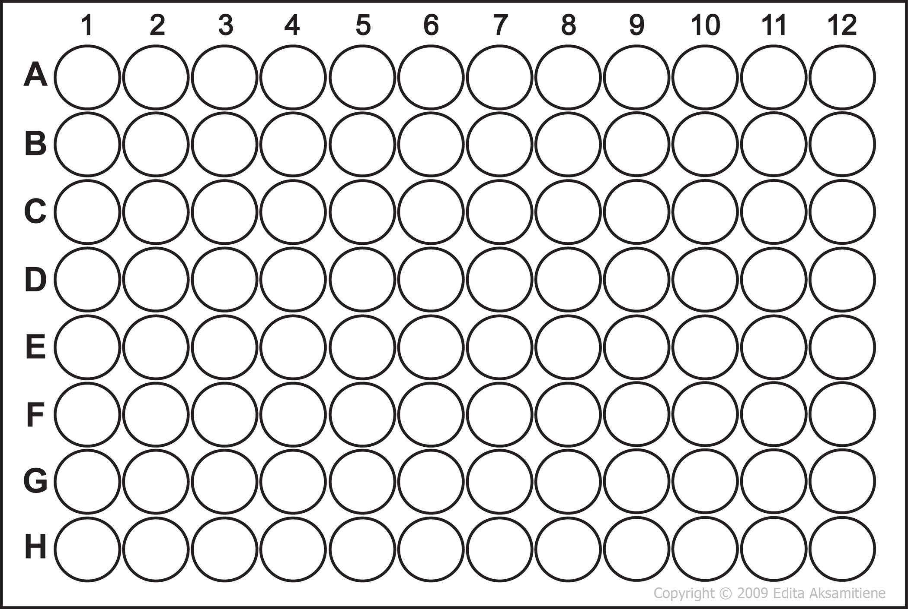
Umbrella Trial with Multiple Treatment Arms
Inform clinical decisions or suggest targeted therapies
sensitive
resistant
Research Study Example: BeatAML, HNSCC
Notes:
Describe precision medicine
Describe how we can research precision medicine
Explain the tools that we use for this.
Goal of precision medicine is to match each patient with the best therapy, which is specific to cancer type, somatic mutations and genome.
But to determine gene targets associated with drug sensitivities, or other optimal therapy, - requires exploring the effects of many drugs on many patients. We can’t test potentially ineffective or detrimental drugs on patients, so the next best way to explore the precision medicine space is by taking malignant samples from each patient, and running them through a drug panel, where the sample response can be characterized.

Slide 3
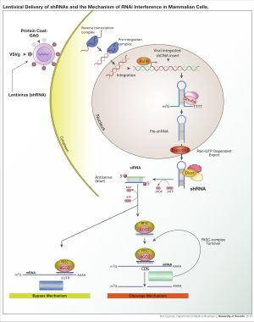
Response Datatype: Pooled Gene Dependency
Cell Line
shRNA (Genre KO)
Let cells grow
~16 doublings
Transfect shRNA
or Crispr into cells
(Gene KO/Knock-Down)
Relative Abundance
T0:
Cells(Y) = 1/5
Cells(B) = 1/5
Cells(G) = 1/5
T1:
Cells(Y) = 1/10
Cells(B) = 2/10
Cells(G) = 5/10
Log2(fold change)
Dep(Y) = -1.0
Dep(B) = 0.0
Dep(G) ~ 1.3
Short hairpin RNA. Wikipedia (2019).
Luo, B. et al. Highly parallel identification of essential genes in cancer cells. Proc. Natl. Acad. Sci. U.S.A. 105, 20380–20385 (2008).
Notes:
Produce ~5 shRNA per protein coding gene
In a given cell-line in-vitro:
Transfect shRNA(s) with multiplicity of ~0.3
Culture cells for period of time (~16 doublings)
Isolate the shRNA sequences by PCR amplification
Measure relative abundance of each shRNA
Output variable is log transformed relative abundance
If knocking out a gene is stimulatory to cell proliferation the relative abundance will increase and our output variable will be positive
If knocking out a gene is inhibitory to cell proliferation the relative abundance will decrease and our output variable will be negative

Slide 4
Profiling Relative Inhibition Simultaneously in Mixtures (PRISM)
Apply Drug
&
Let cells grow
Cell Line
Relative Abundance
T0:
Cells(G) = 1/3
Cells(B) = 1/3
Cells(R) = 1/3
T1:
Cells(G) = 1/6
Cells(B) = 2/6
Cells(R) = 3/6
Log2(fold change)
Dep(Y) ~ -1.0
Dep(B) = 0.0
Dep(G) ~ 0.6
PRISM: A Novel Bead-Based Biological Barcode Assay. Luminex Corporation https://www.luminexcorp.com/blog/prism-a-novel-bead-based-biological-barcode-assay/ (2016).

Slide 5
Data Availability
HNSCC Project
~2k obs.
# Patients ~ 20
# Drugs ~ 200
Tumor Features
RNAseq
DNAseq
CNV
Histology
Clinical Features
BeatAML
~60k obs.
# Patients ~ 600
# Drugs ~ 122
Tumor Features
RNAseq
DNAseq
CNV
Histology
Clinical Features
Cancer Dependency Map (DepMap)
> 20 million obs.
# Cell Lines ~ 1000
# Drugs ~ 400+
# Gene Targets ~ 18,000+
Tumor Features
RNAseq
DNAseq
CNV
Flow of information

Slide 6
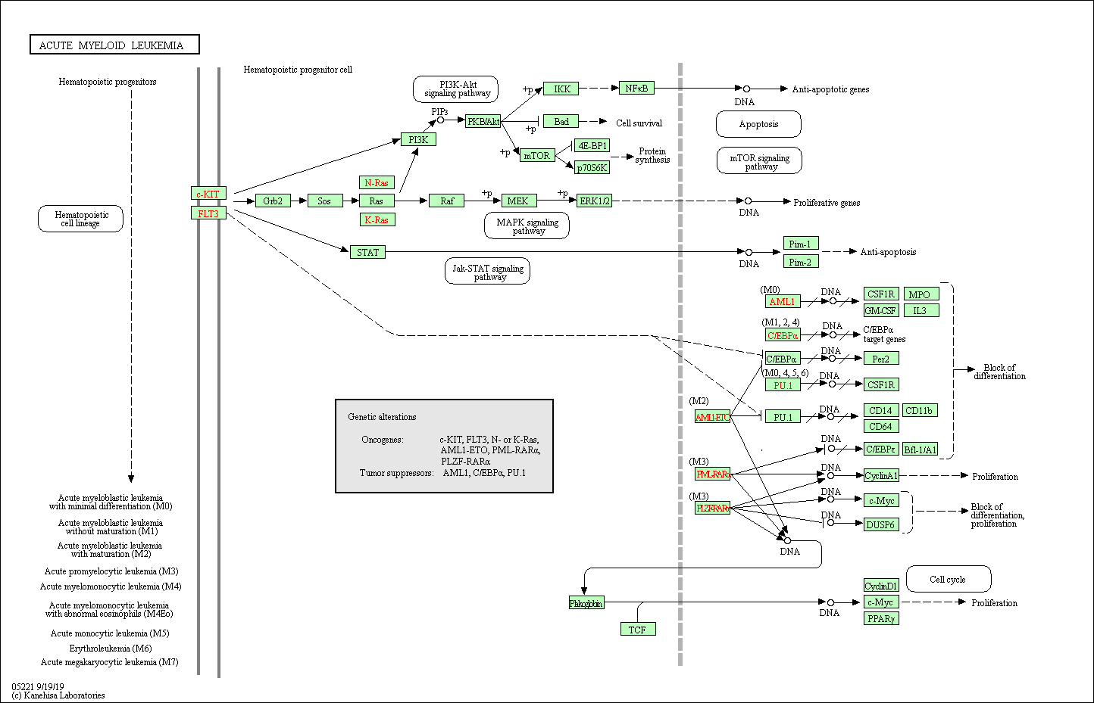
Variable Selection: AML Pathway Genes
KEGG Pathway:
hsa05221
68 Genes Implicated

Slide 7
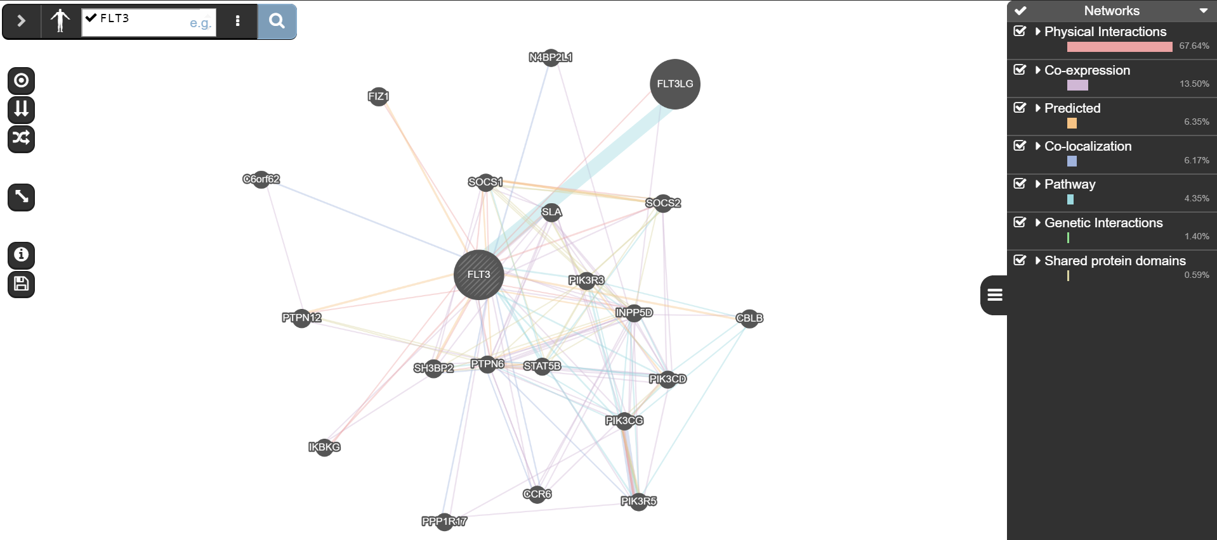
Variable Selection: Associated AML Genes
GeneMania [Other: Reactome, Kegg, StringDB]

Slide 8
Dataset
(resp. type)
AML
Y1
FC1
FC2
CCLE
Y2
GDSC
Y3
Conv
(1x2)
FC3
RNAseq
CTRP
Y4
Gene Targets
CRISPR
Y5
RNAi
Y6
Relu
BN
DO
PRISM
Y7

Slide 9
Encoding
Decoding
FC1
FC6
FC2
FC5
RNAseq
Conv
(1x2)
FC3
FC4
Gene Targets
Reconstructed RNAseq
Reconstructed Targets
2
RNAseq
Reconstructed RNAseq
Loss = Sum
2
Gamma x
Targets
Reconstructed Targets

Slide 10
Baseline: BeatAML data only [532 genes]
Loss diverges at high EPOCHs due to a few points at great distance from
Minimum loss (across all configs) ~ 0.4 SSE
1122 OBS.
355 OBS.

Slide 11
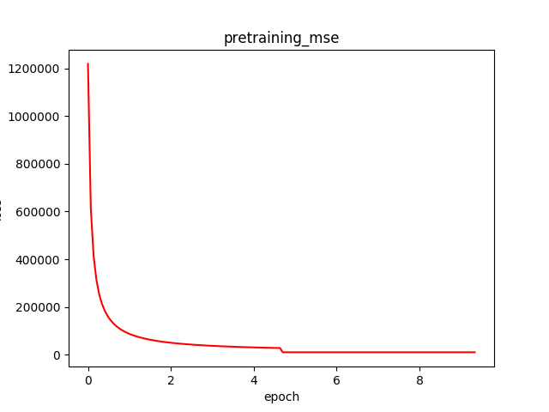
Pretraining Loss; Autoencoder performance
Hyperparameter tuning matters
Bottleneck size
Gamma weight (target weighted loss)
Model complexity
Using the autoencoder seems to help the model converge to a good minima but there is still variability.
Over-pre-training seems to reduce model performance.

Slide 12
Performance All Data
>500k OBS.
~100k OBS.
Important pieces to note:
To even out gradient from each response: normalize outputs
[TODO] Dataset gradient weighting
[TODO] optional parameter to train datasets with specified prevalence
Need more training time and to tune hyperparameters
Potentially only use subset of available datasets

Slide 13
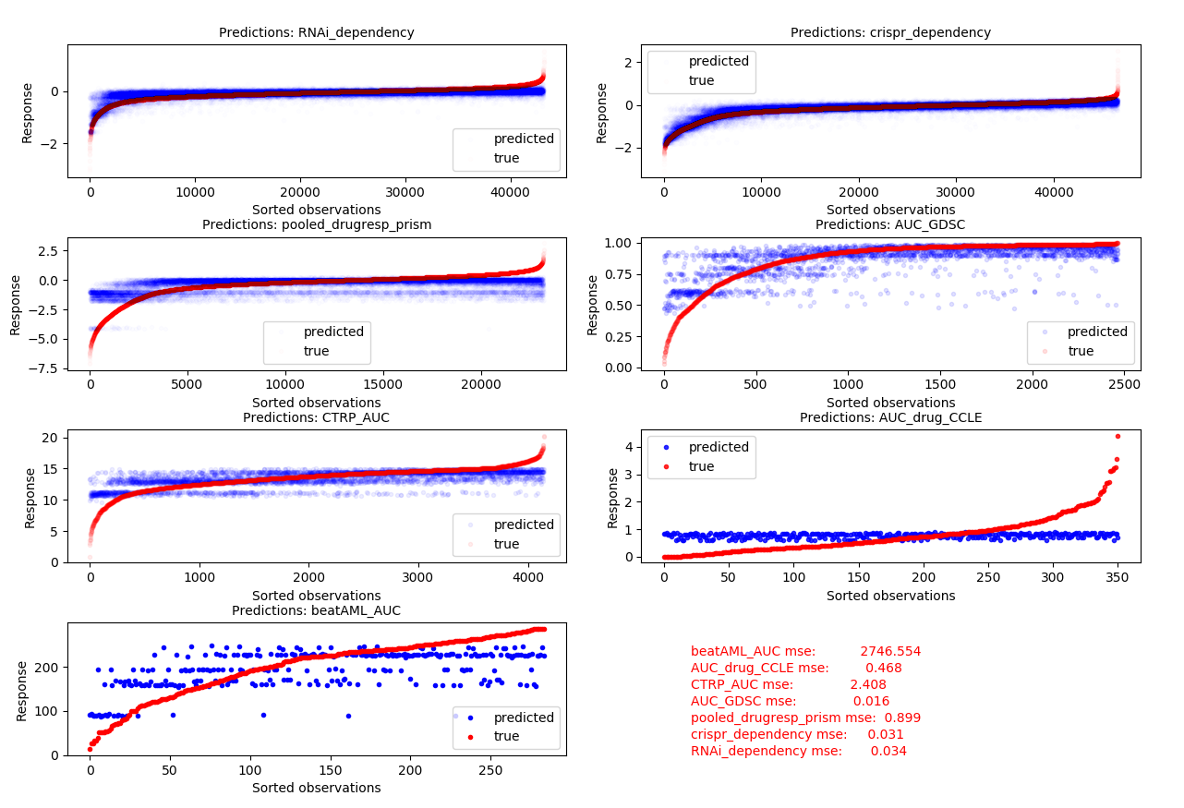
Performance: All Data
Need better metric to compare across datasets

Slide 14
Discussion
Extensions
Use other genomic feature types (DNAseq, Methylation, Copy Number Variation (CNV), HI-C)
Train autoencoder using greater variety in genomic data
Current datasets ~ 1500 unique genomes
Could use TCGA to train far greater number of cancer genomes + randomly permute target labels
Use structural information encoded in gene-gene interaction networks
Graph Network: Feature extraction via message passing -> Feed into current model (FFFC)
Multiple structural datatypes
Protein-Protein Interactions (Pathway information; Reactome, KEGG)
HI-C Data: Genome interactions (TADS, chromatin interactions, dynamic gene-gene interactions)
Co-expression Networks (StringDB, GeneMania)
Co-localization Networks (StringDB, GeneMania)
ISSUES
Difficulty interpreting MSE loss
Given data volume, training the ALL_DATA model took significant time
Didn’t have access to exahead GPU partition
Exahead priority is a limiting factor
Debugging exahead issues / transferring data between local and exahead
Knowing which hyperparameters to focus on during tuning

Slide 15

Questions
Shoutout to
Jacob & Gareth for helping me re-learn exahead necessities

Slide 17
Extensions / Still-in-progress
Weight loss function by dataset to increase relevance of small beatAML dataset and mitigate dataset size imbalances.
Implement Graph Neural Network Feature Extraction
Finish Bayesian Neural Network (can’t get it to converge)
Model predictor variables as Random Variables in a Bayesian framework.
Allow for imputation given missing data, propagate effect to response inference
Use training set to estimate a posterior that can be used as prior for test/validation/add-n data
Add in noise to training – potentially more robust model (analogous to image transformations in image processing)
Rework beatAML response to sensitive, intermediate, resistance to improve the interpretability across models.

Slide 18
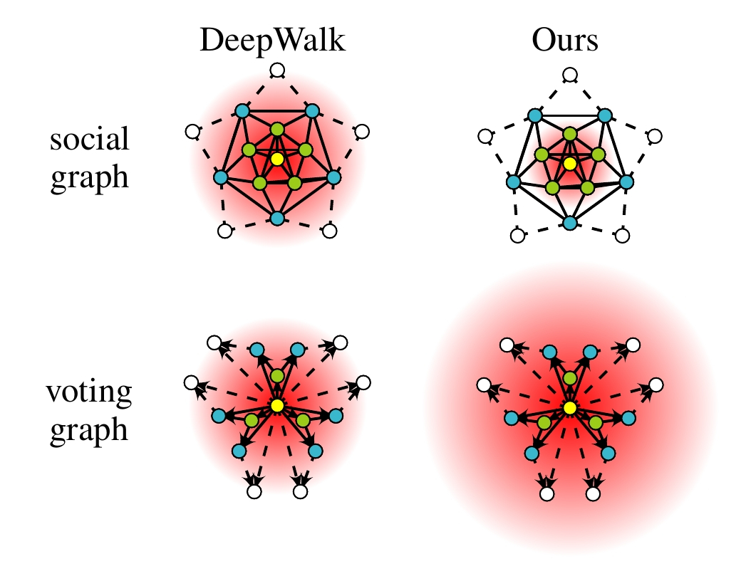
Graph Embedding
Goal:
embed gene-gene interaction network into 2-dimension
discretize over high density range
Overlay expression, targets (and/or other features)
Treat as “Expression Image”
Train with CNN
Visualize with CNN methods
kernel viz
latent space activations
Issue – Embedding large dense graphs into 2D is inherently difficult and poses a ton of issues. Main issue was all the points collapse into a few points… Wasted a ton of time writing custom loss functions to try to prevent this with no luck.
Also, after some reading, this was a major avenue of research (spectral NN; Fourier space convolutions) in the last 10 years and has converged back to message passing (graph neural nets / probabilistic graphical models)
<SHOW THE RESULT I DO HAVE>
https://github.com/benedekrozemberczki/AttentionWalk

Slide 19
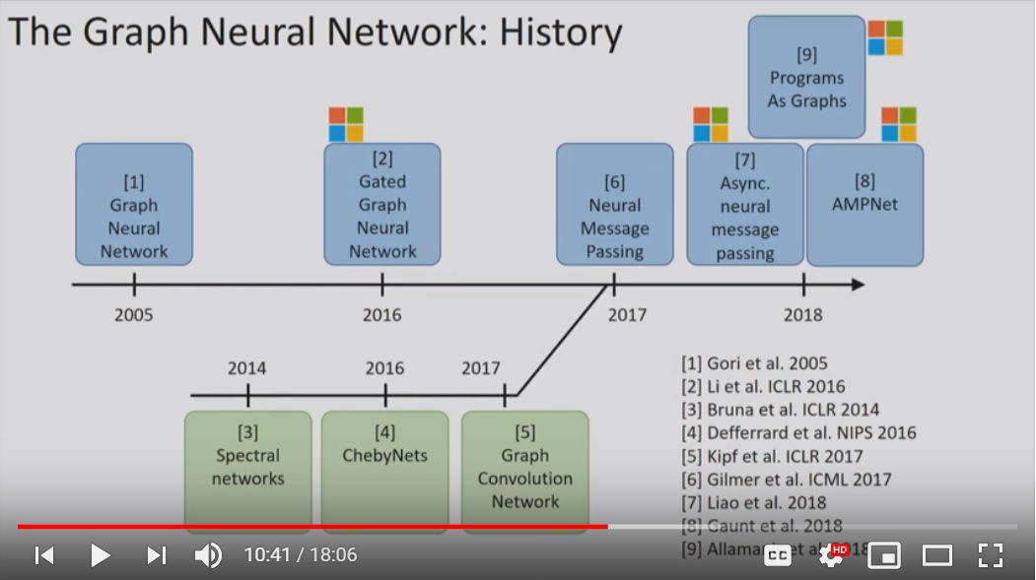
Graph Embedding
If we want to include structural (gene-gene interactions data) then the best method is most likely message passing in graphical neural networks.
https://www.youtube.com/watch?v=cWIeTMklzNg&list=PLJHJC-Uj4rd8B0CCAAe63g5d_oZBdLWj6&index=3&t=0s

Slide 20
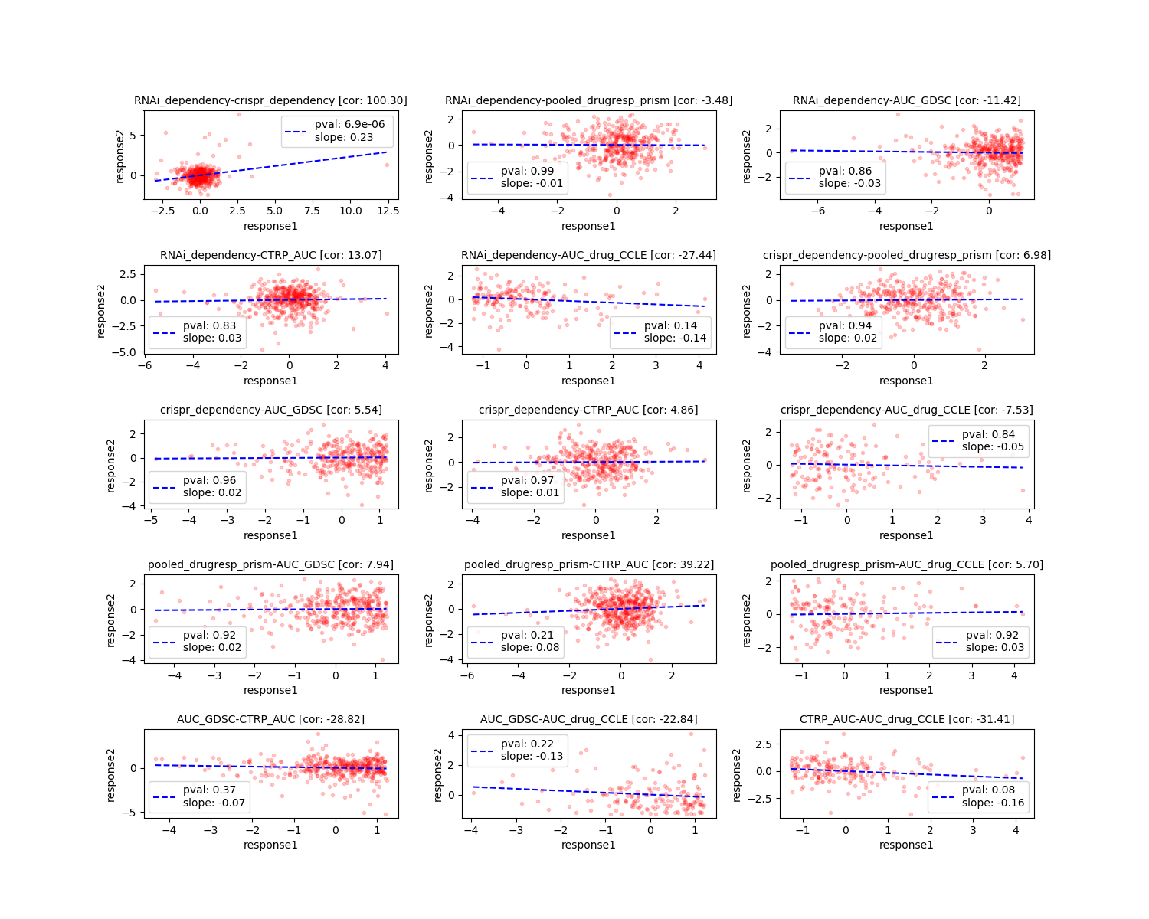
Dataset Agreement
Group by:
Dataset
Cell-Line
Gene Target
Aggregate by mean
For each pairwise dataset:
Filter to shared expr/targets
Scale responses (zscore)
Plot expr-taget correlation
Fit lm – extract pval
BeatAML doesn’t share any expr cell lines… can’t compare for now (Could potentially use expr-similarity to compare)

Slide 21
Traditional Dose-Response Data
Genomics of Drug Sensitivity in Cancer (GDSC)
24 drugs
504 cell-lines
~250k observations
BeatAML
386 drugs
529 patients
~73k observations
DepMap Achilles/Avana; Pooled CRISPR
18333 genes
625 cell lines
~11 million observations
Cancer Cell Line Encyclopedia
(CCLE)
24 drugs
492 cell-lines
~12k observations
HNSCC
238 drugs
20 patients
~3k observations
Gene-Dependency
Data
Cancer Target Discovery and Development (CTD2)
645 Drugs
481 Cell Lines
~260k Observations
DepMap RNAi Combined Data
17309 genes
712 cell lines
~12 million observations
DepMap; PRISM Barcoded & Pooled cell-line drug response data
4686 compounds
578 cell lines
~2 million observations
Drug Data
Notes:
Genomics of Drug Sensitivity in Cancer. (GDSC) We have characterized 1000 human cancer cell lines and screened them with 100s of compounds
The Cancer Cell Line Encyclopedia (CCLE) project started in 2008 as a collaboration between the Broad Institute, and the Novartis Institutes for Biomedical Research and its Genomics Institute of the Novartis Research Foundation. The goal is to conduct a detailed genetic and pharmacologic characterization of a large panel of human cancer models, to develop integrated computational analyses that link distinct pharmacologic vulnerabilities to genomic patterns and to translate cell line integrative genomics into cancer patient stratification.
DepMap: The Cancer Dependency Map Project at Broad Institute
Cancer Therapeutics Response Portal (CTRP)
CTD²: Cancer Target Discovery And Development
The Cancer Target Discovery and Development (CTD²) Network, a functional genomics initiative, bridges the gap between cancer genomics and biology. The Network aims to understand how tumor heterogeneity leads to drug resistance in order to develop optimal combinations of chemotherapy or small molecules in combination with immunotherapy.

Slide 22
Dataset Subsets
set sizes: RNAi_dependency -> test -> 57208
set sizes: RNAi_dependency -> train -> 186480
set sizes: RNAi_dependency -> val -> 42851
set sizes: crispr_dependency -> train -> 202124
set sizes: crispr_dependency -> val -> 46594
set sizes: crispr_dependency -> test -> 62250
set sizes: pooled_drugresp_prism -> train -> 98993
set sizes: pooled_drugresp_prism -> test -> 30535
set sizes: pooled_drugresp_prism -> val -> 22899
set sizes: AUC_GDSC -> train -> 10824
set sizes: AUC_GDSC -> test -> 3333
set sizes: AUC_GDSC -> val -> 2507
set sizes: CTRP_AUC -> train -> 17995
set sizes: CTRP_AUC -> test -> 5497
set sizes: CTRP_AUC -> val -> 4138
set sizes: AUC_drug_CCLE -> val -> 339
set sizes: AUC_drug_CCLE -> test -> 471
set sizes: AUC_drug_CCLE -> train -> 1473
set sizes: beatAML_AUC -> train -> 1122
set sizes: beatAML_AUC -> val -> 272
set sizes: beatAML_AUC -> test -> 355
~500k observations
~2000 observations

Slide 23
Variable Selection: Associated AML Genes
Download GeneMania DB of aggregated Gene-Gene Interactions:
For each gene implicated in the AML pathway:
Find first order neighbors of Gene-Gene Interactions
given this collection of genes:
Filter to 500 genes by highest edge weights
genemania edge weights ~ predicted importance for inferring gene function
This provides genes in the AML pathway AND genes that have strong evidence/predicted-importance for gene-gene interactions with these AML genes.
EXTENSION: Future models can use gene-gene interaction network in a more structured method (eg Graph Neural Networks)

